Slide 1


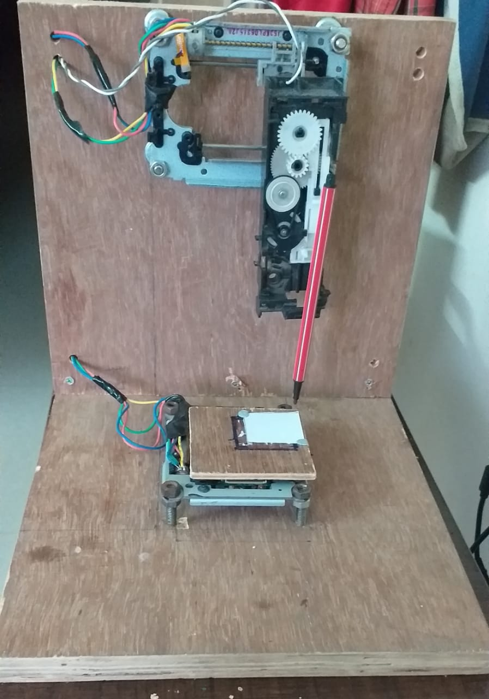
CNC Soldering machine
MENTOR:
Ashiq Rahman anwar batcha
Team Members:
Girinath R
Karthikeyan N
Kasi viswanathan S
Vasanth kumar v

Slide 2
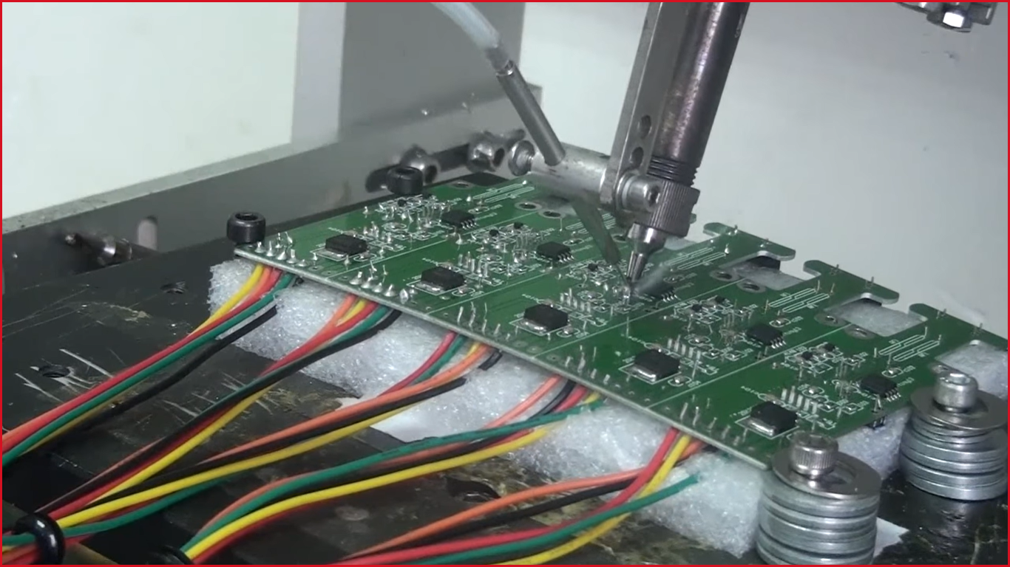
Abstract:
We ECE students spend a lot of time in soldering ICs and other electronic components which is a very trivial task when compared to designing and testing. It would be awesome if we have a machine that does the soldering process after we design. The objective of our project is to build a Computer Controlled Soldering Machine that can solder Through Hole components placed on a PCB. It takes the co-ordinates of soldering points from a file generated by EDA software (Eagle/Altium) which are processed and fed to a micro-controller based device. This in turn controls the actuators and get our work done. This prototype would save a lot of circuit-building time.

Slide 3
LITERATURE SURVEY
S. No. | TITLE OF THE JOURNAL | NAME OF THE AUTHOR | YEAR OF PUBLICATION | INFEREFENCE | URL
1. | How to make Arduino mini CNC plotter machine | Sandeep | 27/09/2019 |  | Click here
2. | Control Stepper Motor with A4988 Driver Module & Arduino | NA | NA | We have learnt pin description of the A4988 module, its supply requirements and calibration to control any Bipolar Stepper Motor with A4988 module. The safety precautions to be followed so that no damage is caused to the system | Click here

Slide 4
3. | Convert ATX PSU to Bench Supply | NA | NA | Voltage level available on different color wires on a desktop SMPS PSU Steps to convert it, to use it for our electronics project | Click here
4. | Interface L298N DC Motor Driver Module with Arduino | NA | NA | Learnt the pin configuration of L298N DC motor driver Learnt the logic to drive 2 different DC motor as per needs.(FORWARD, BACKWARD, SPEED CONTROL) | Click here
5. | ESP32 / ESP8266 Arduino: Serial communication with Python | Nuno Santos | 02/12/2017 | Learnt the methods/functions available in PySerial module Learnt to provide a bridge between PC and the automated soldering machine wirelessly | Click here

Slide 5
Designing PCB file
Generating CSV file
Extracting soldering points from CSV file using Python
BLOCK DIAGRAM
ESP32 receives the command wirelessly and controls the actuators
The calculated results are sent to ESP32(via Bluetooth from PC)
Calculating steps needed to traverse from one point to another using Python

Slide 6
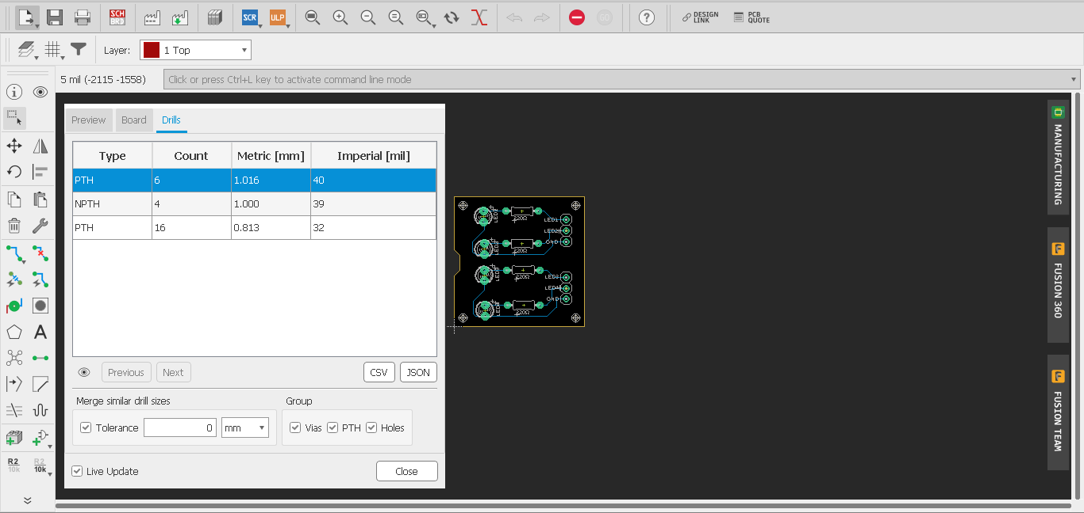
GENERATING CSV FILE FROM EAGLE

Slide 7
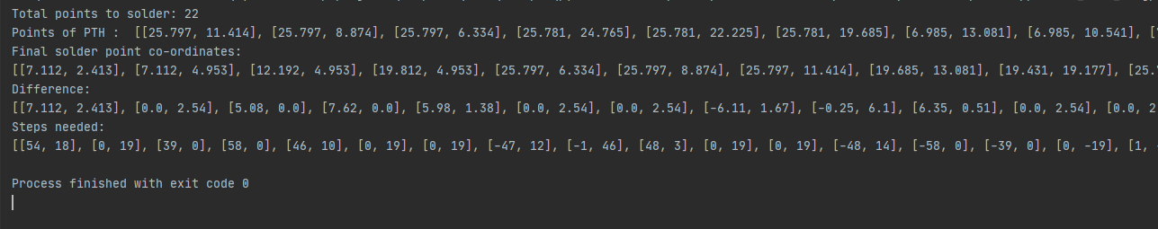
SOFTWARE OUTPUTS:

Slide 8
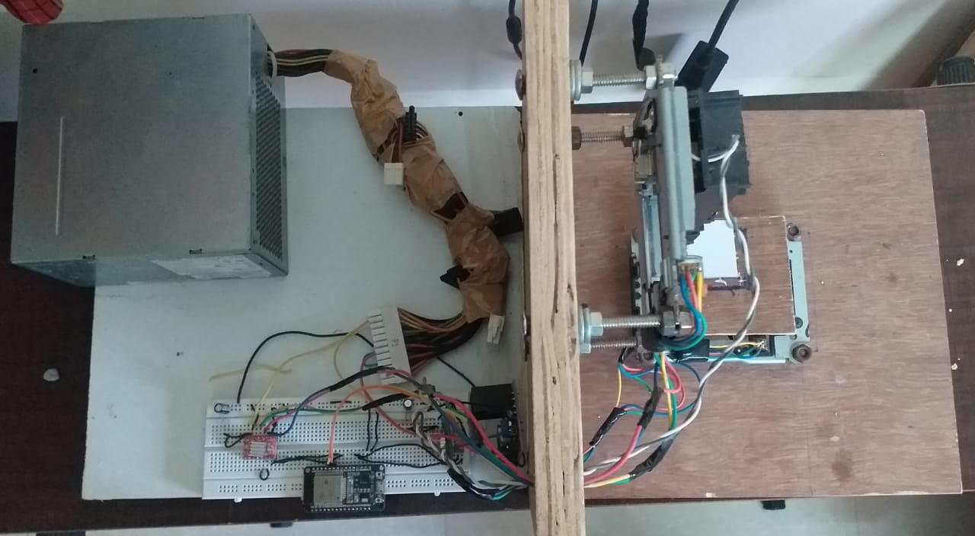
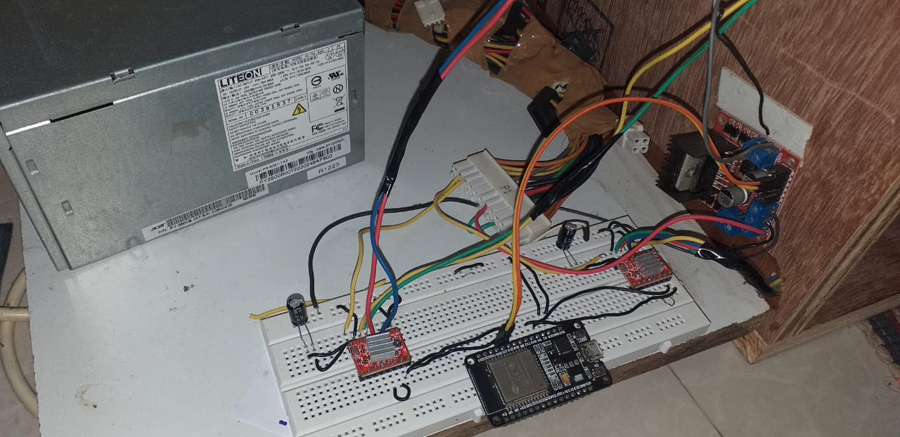
TOP VIEW
CIRCUIT SETUP

Slide 9
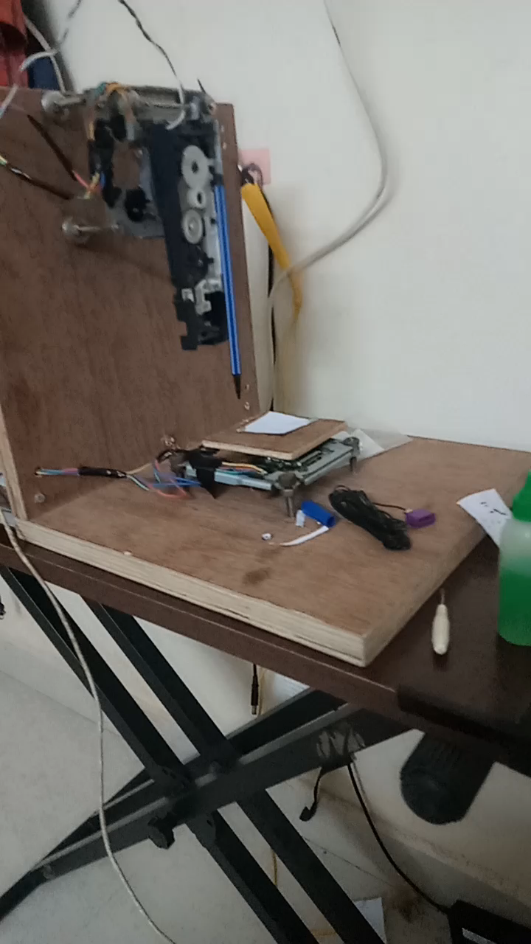
WORKING VIDEO:

Slide 10
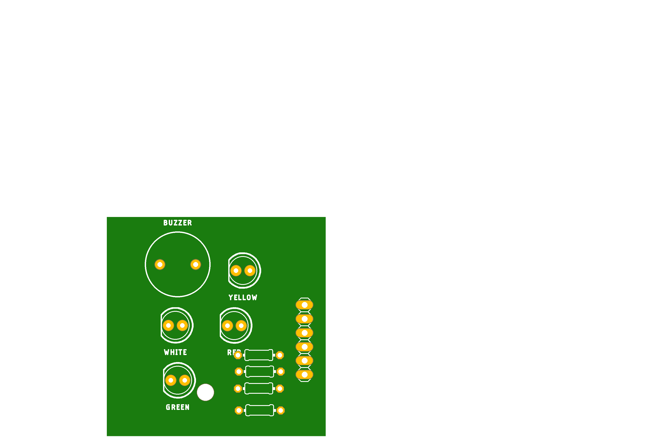
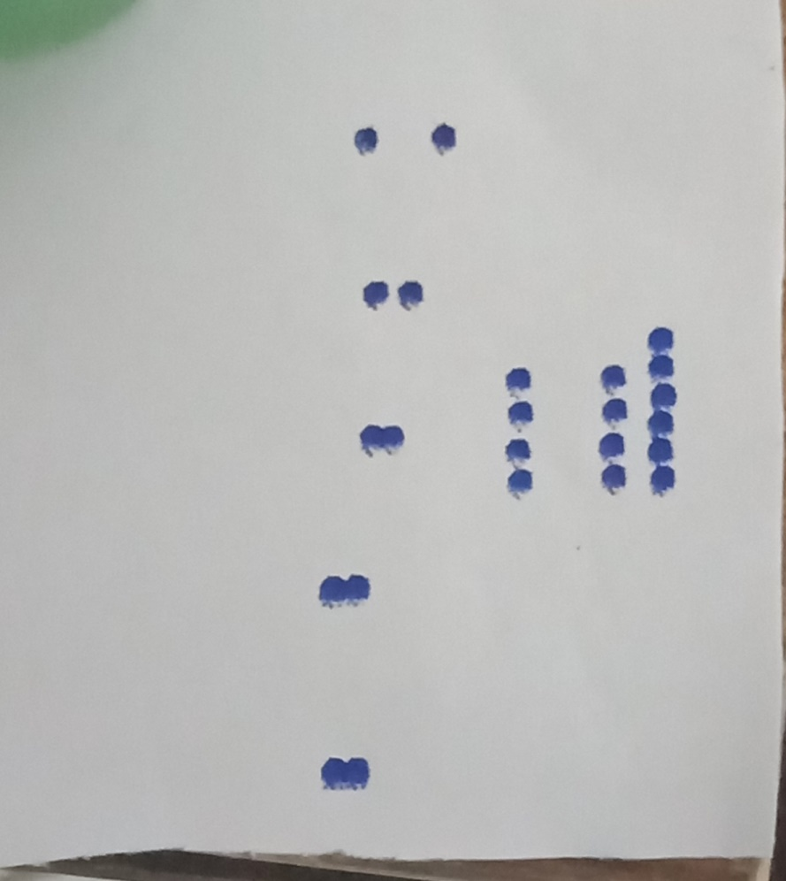
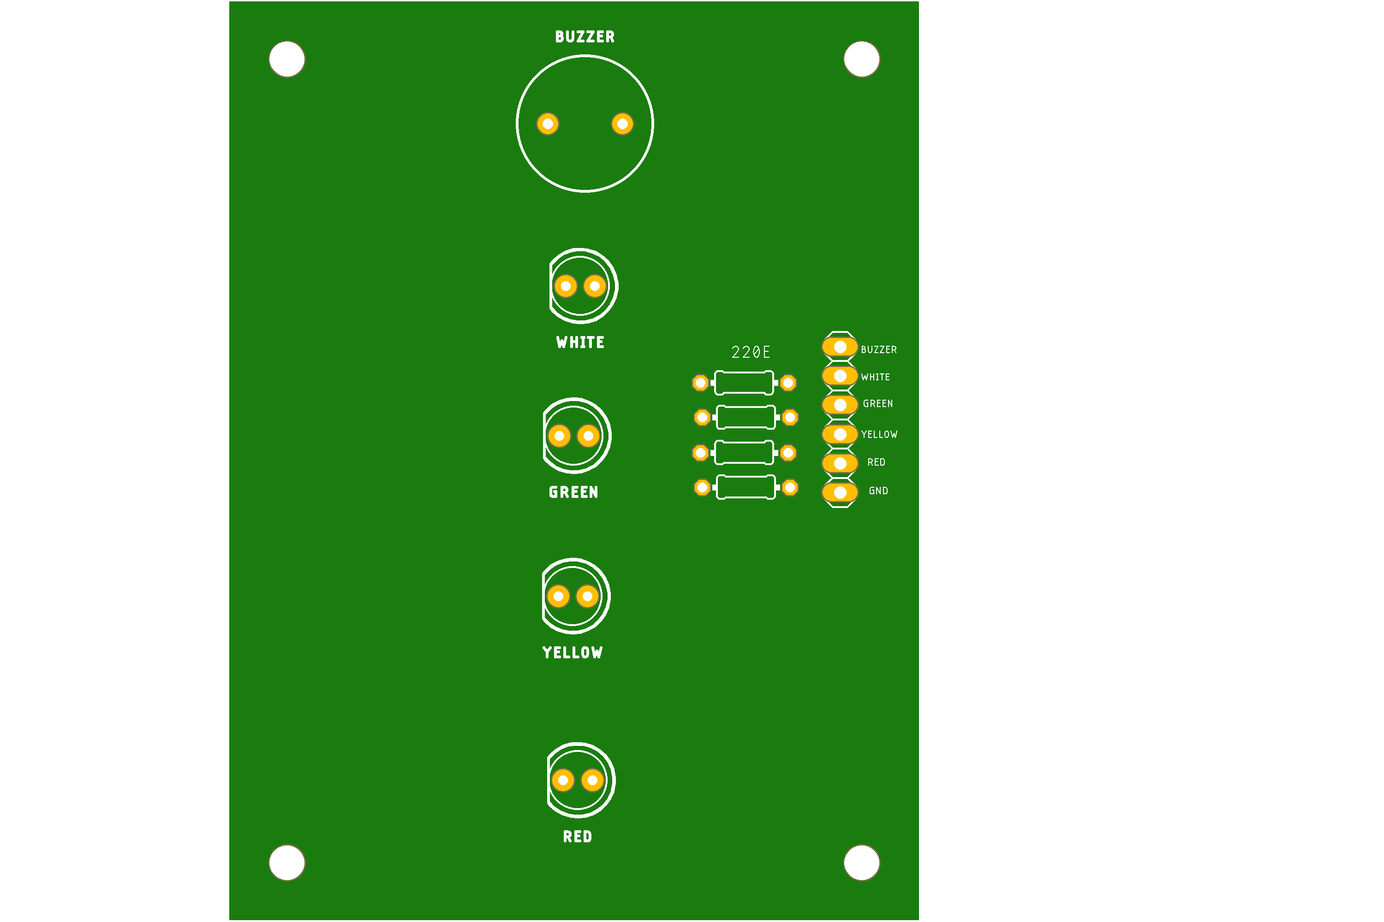
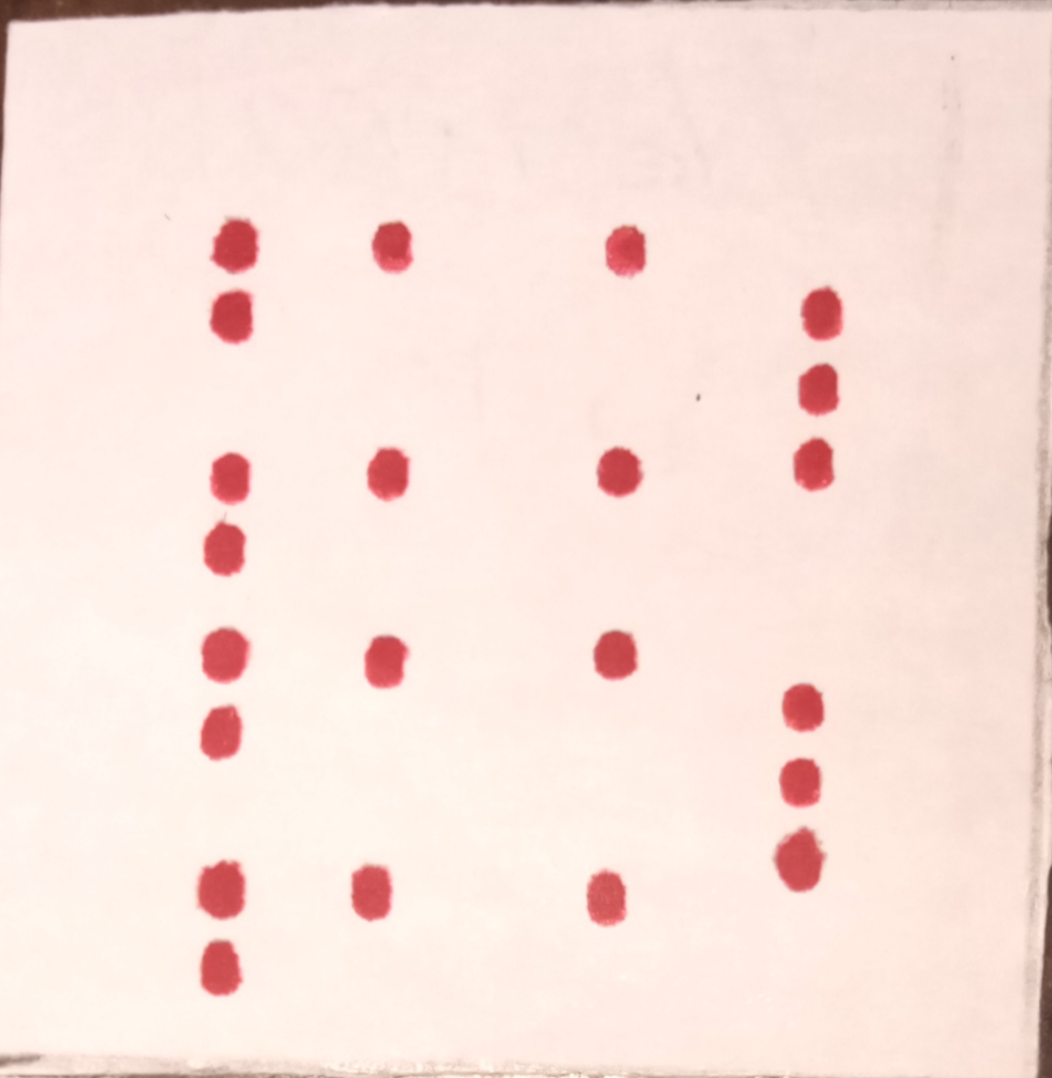
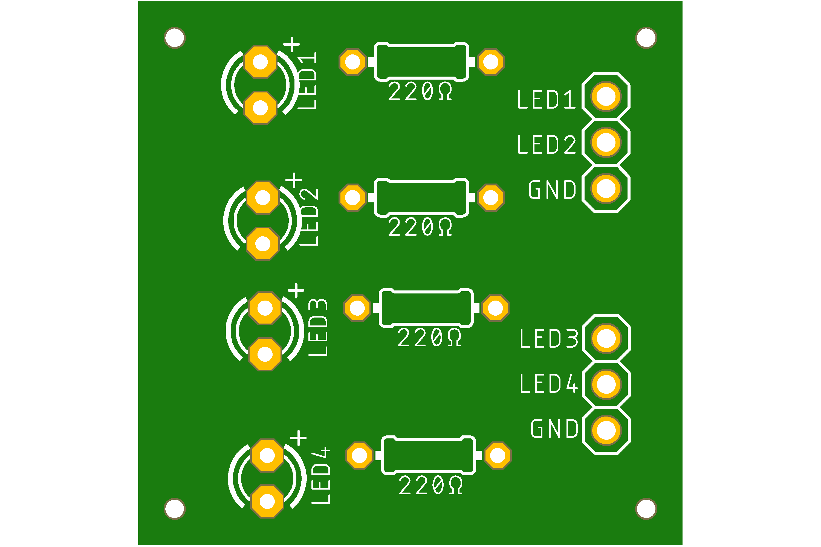
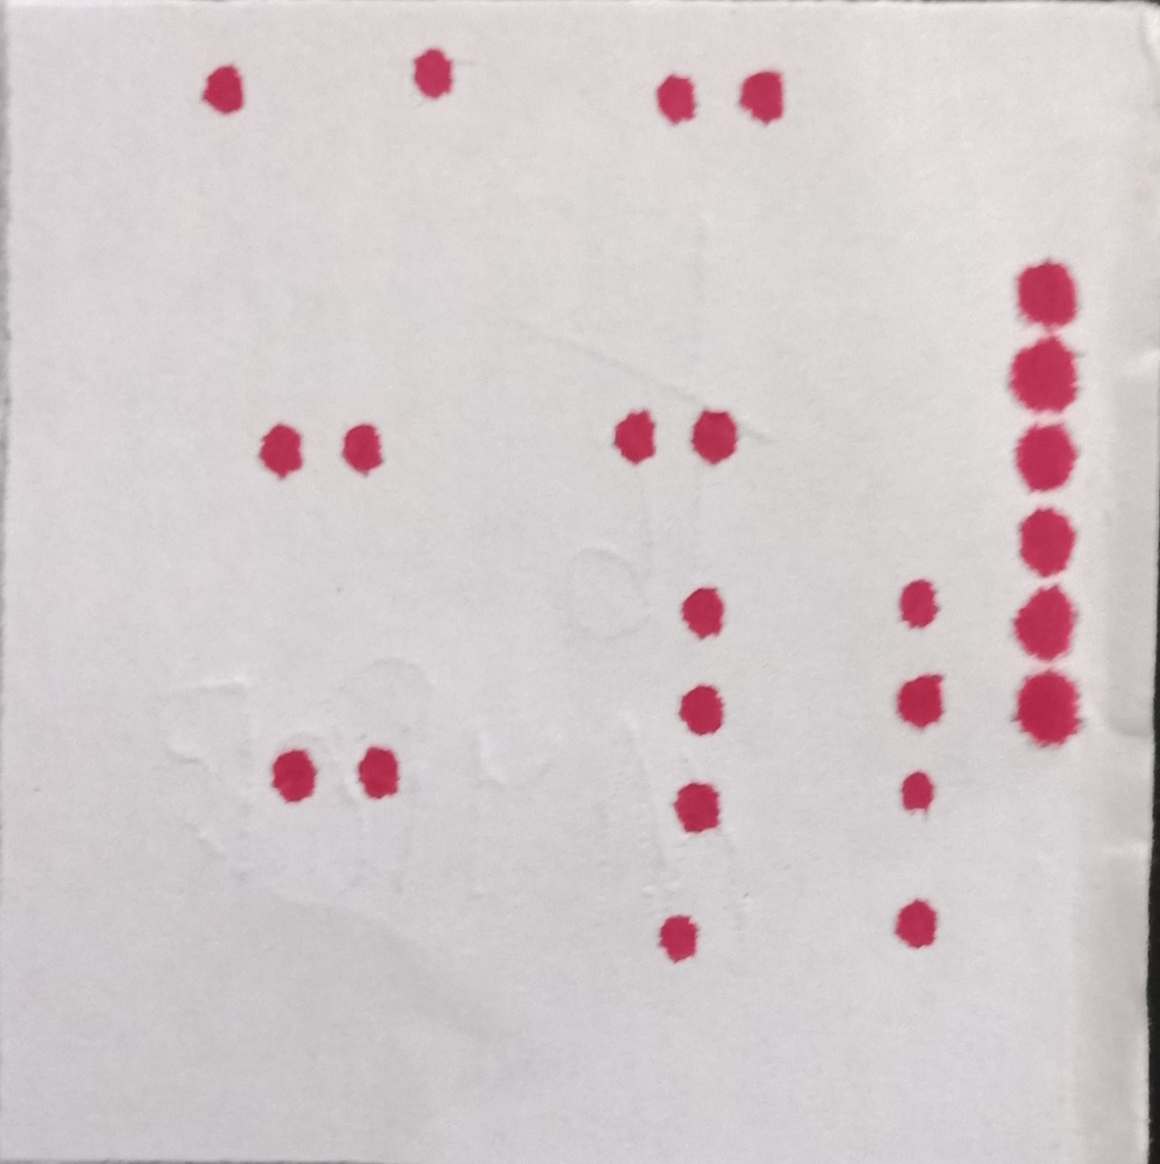
TEST OUTPUTS:

